Slide 1
TÜV Rheinland
Ariba Supplier Manual
Connecting to Ariba Network,
Account Configuration Management,
Document Handling

Slide 2

Use of this manual
This manual is intended to inform suppliers about the supplier business processes requirements of TÜV Rheinland.
You can navigate this manual as follows:
By clicking on the buttons in the toolbar.
By clicking on the links on the pages - these can be words or shapes in the graphics.
Using the bookmarks bar on the left.
If you need further assistance, click the help button at the bottom of each page to find the right support contact.
Use the tabs in the lower left or right corner to access our community support pages. These will provide you with answers to the most frequently asked questions.
This button takes you to the previous page
This button takes you to the next step
This button takes you back to the beginning of the chapter
This button takes you back to the beginning of the presentation

Slide 3
Agenda
Ariba Network – an Overview
Account Setup
Purchase Orders
Other Documents
Invoice Types

Slide 4
Agenda
Ariba Network – an Overview
Account Setup
Purchase Orders
Other Documents
Invoice Types

Slide 5
Ariba Network Overview
What is Ariba Network?
Project scope for TÜV Rheinland
Value for suppliers
Supported documents
Unsupported documents

Slide 6
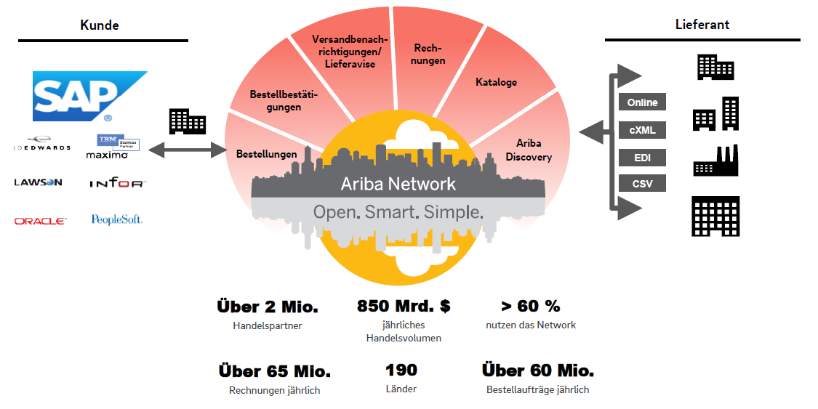
What is Ariba Network?
TÜV Rheinland has chosen Ariba Network as its electronic transaction provider. As a preferred supplier, you have been invited by us, your customer, to become a member of the Ariba Network in order to conduct transactions with us or any of your customers electronically.

Slide 7
TÜV Rheinland Specifications
Supported documents via Ariba Network
Project specifics for TÜV Rheinland:
Tax data is accepted at the invoice header/summary level or at the item level of the invoice.
Shipping data is accepted at the invoice header/summary level or at the line item level. If Collaborative Supply Chain is enabled, shipping data is added at the invoice header/summary level.
Orders
Order Confirmation Compared with a complete purchase order or line item. | Invoices for Blanket Purchase Orders Compared with a blanket purchase order.
Shipping Notifications/Delivery Notes Compared with a purchase order when PO items are shipped. | Service Invoices Invoices requiring details of service items.
Detailed Invoices Compared with a single purchase order that refers to one item. | Invoice Corrections Item level corrections; price/quantity corrections.
Partial Invoices Compared with a specific item from a single purchase order. | Performance record sheets. Compared with a single purchase order that refers to a line item

Slide 8
TÜV Rheinland Specifications
Unsupported documents via Ariba Network
Invoices without purchase order
Reconciliation with a purchase order which was not received through Ariba Network
Invoicing for corporate credit cards (P cards)
An invoice for an order placed using a company credit card will not be accepted by TÜV Rheinland
Invoice duplicates
Each invoice must have a new and unique invoice number; TÜV Rheinland rejects duplicate invoice numbers and such invoices will be
returned, unless it is an invoice that was corrected and was previously marked with a "Failed" status on Ariba Network.
Paper invoices
TÜV Rheinland requires electronic invoices submitted via Ariba Network; TÜV Rheinland no longer accepts paper invoices.
Bundle or consolidated invoices (if vendor integration is not available)
Comparison of an invoice with several orders is not accepted by TÜV Rheinland.

Slide 9
TÜV Rheinland Specifications
Additional Requirements
Purchase Orders must be confirmed (order confirmation) before an invoice can be issued.
Purchase orders must be confirmed before a service entry sheet can be created.
Service-entry-sheets must be approved by TÜV Rheinland before an invoice can be issued.
Remittance ID Specification (IBAN) must be stored by the supplier on his Ariba Network account.
For additional, customer-specific guidelines, please check the TÜV Rheinland‘ transaction guideline which can be found in your Ariba Network account. You can find instructions on how to do this in the "Invoices" section of this manual.

Slide 10
SAP Ariba can help you...
to work immediately with all trading partners.
Direct access to the online invoicing tool.
Automate and publish catalogs to buyers in less than 8 weeks.
from paper to efficient electronic transactions.
75 % faster closing of deals.
75 % higher productivity in order processing through cXML.
80% greater accuracy of orders thanks to PunchOut.
Detect and fix errors before they even occur.
64% fewer manual edits.
Track invoice and payment status online in real time and shorten days sales outstanding.
62% reduction in late payments.
68% higher bill match rate.
Identify opportunities you've missed and trade globally.
15 % stronger customer loyalty.
30 % increase in existing customers.
35 % growth in new business.

Slide 11
Agenda
Ariba Network – an Overview
Account Setup
Purchase Orders
Other Documents
Invoice Types

Slide 12
Account Setup
Account Configuration
Activation Tasks
Advanced Account Configuration
Configuration Requirements
Accept the invitation
Profile Completeness
Notifications by e-mail
Activation Tasks
Purchase order forwarding
Invoice Notifications
Tax Details
Referrals
Customer Relations
Roles and Users
Advanced User account functions
Test accounts

Slide 13
Account Configuration specific to TÜV Rheinland
Remittance address: Select "Company Settings" in the upper right corner and click on "Remittances". In the section "Remittances by ELV/Cheque" click on the option "Create" and fill in all mandatory fields marked with an asterisk (*).
Payment methods: In the upper right-hand corner, select "Corporate Disbursements" and click on "Remittances". In the "ELV/Check Transfers" section, click on "Create/Edit". In the "Payment Methods" section, select from "Automated Clearing House", "Check", "Credit Card", or "Electronic Funds Transfer". Enter the details. You will receive the wire transfer ID from your buyer.
Create a test account (testing is required for integrated suppliers and catalog suppliers):To create a test account, select your name in the upper right corner and select "Switch to Test ID".
Currency: The currency Ariba Network uses in the service subscription area of your account depends on your company's location, which you specify in User Account Navigator > My Account > Preferences.

Slide 14
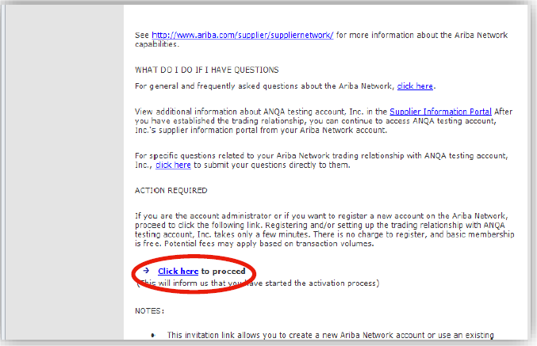
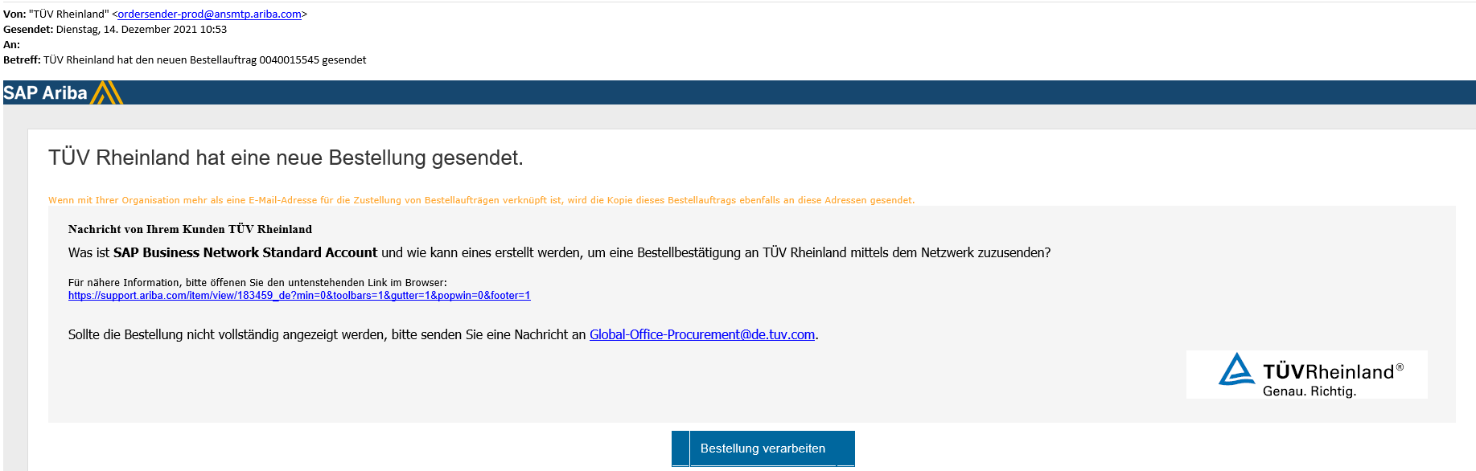
TRR - Accepting an Invitation to Do Business with TÜV Rheinland
Step 1
The invitation is also referred to as a request to establish a business relationship (TRR). This email contains information on how to conduct transactions with your customer electronically.
The message generated from the system has sender: ordersender-prodansmtp.ariba.com as sender.
Click on the link or button in the email to go to the landing page and create the business relationship with TÜV Rheinland via your Ariba Network account:
Invitation via e-mail.
Invitation via interactive order email.
Supplier

Slide 15
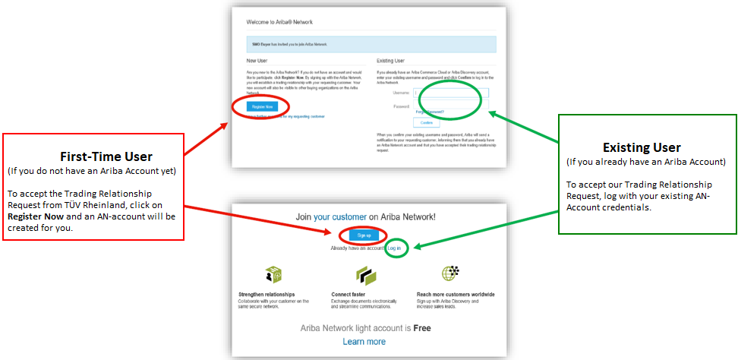
TRR - Accepting an Invitation to Do Business with TÜV Rheinland
Step 2

Slide 16
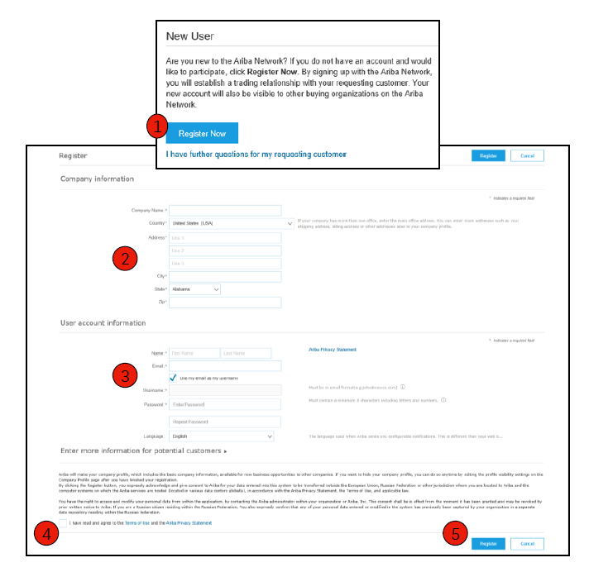
Registering as a New User
Click Register Now.
Provide company information in asterisked (*) fields:
    Company Name
    Country
    Address
Please fill in the fields marked with an asterisk (*):
    Name
    E-mail address
    Username (if different from email address).
    Password
Accept the terms of use by checking the box.
Click on Register.

Slide 17
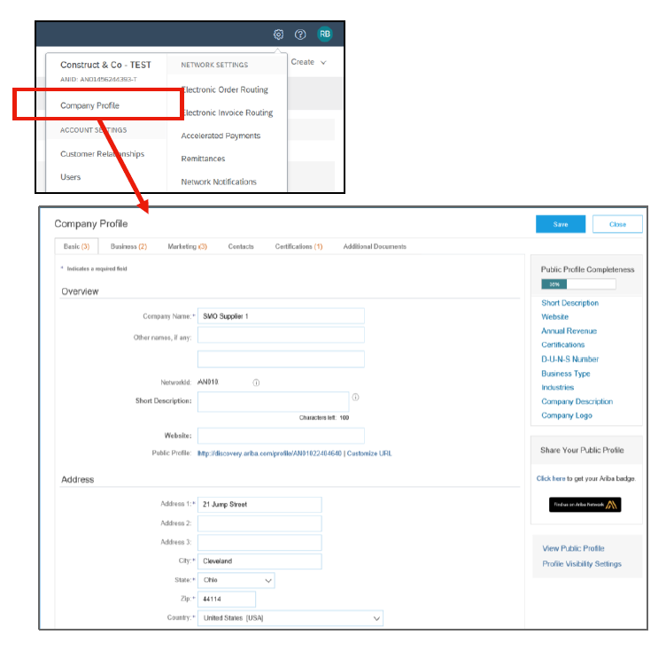
Complete Your Profile
From the Company Settings drop-down menu, select Company Profile.
Fill in all the suggested fields on the tabs to best describe your business.
Achieve 100% in the completeness of your public profile by entering the information listed below.
Note: The more complete a profile is, the more likely it is to increase business value with existing and potential customers.

Slide 18
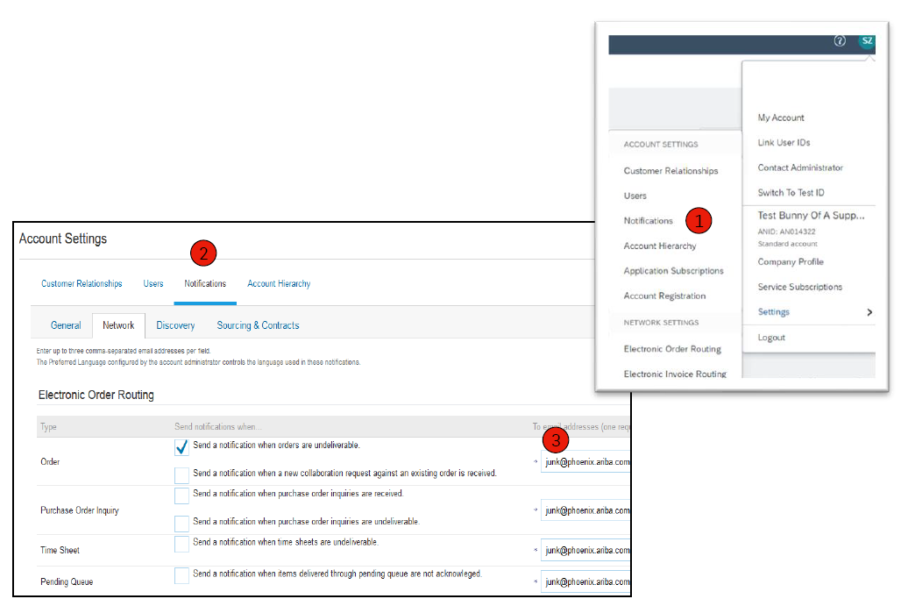
Configuring eMail Notifications
In the "Ariba Network Notifications" section, you specify which notifications you would like to receive. There you can also specify to which email addresses they should be sent to.
Under "Company settings", click on "Notifications".
Ariba Network notifications can also be accessed from here. However, you can also switch to the Ariba Network tab in the Notifications area.
Enter up to three email addresses per notification type. You must separate the email addresses with commas, but do NOT include spaces between the addresses.

Slide 19
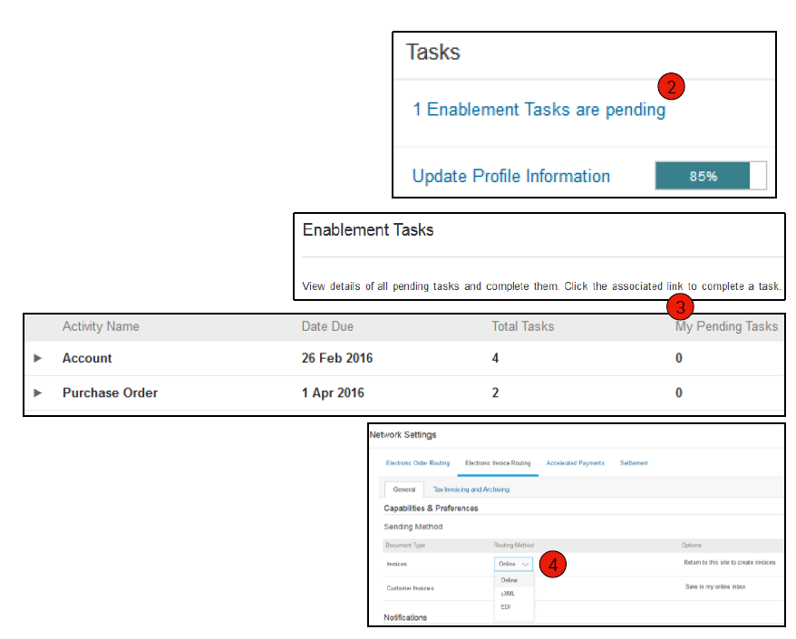
Configuring Enablement Tasks
On the Home screen, select the Enablement tab.
Click on the link for pending enablement tasks.
Select the pending tasks required to complete.
Define your method for electronic order forwarding and electronic invoice forwarding (not all options are possible for standard accounts) by select one of the possible forwarding methods:
    Online
    cXML
    EDI
    Email
    Fax
    Queue for pending cXML documents (only available for order forwarding)
Note: Occasionally, you may see a pending task for TÜV Rheinland. This will continue to display until TÜV Rheinland completes the task.

Slide 20
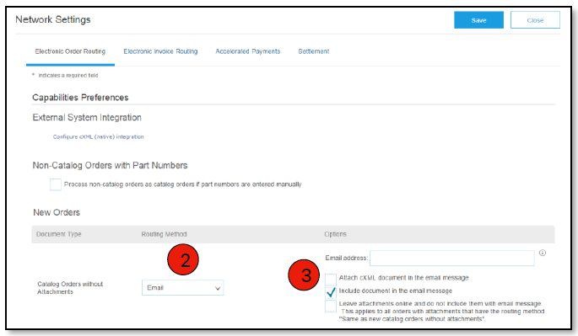
Selecting an Electronic Order-Forwarding Method
Click the "Task" link to configure your account.
Select one of the following forwarding methods (not all options are available for Standard Account):
    Online
    cXML
    EDI
    Email
    Fax
    Queue for pending cXML documents (only available for order forwarding)
Enter at least one e-mail address. You can enter up to 3 email addresses, separated only by a comma (no spaces!).

Slide 21
Forwarding Purchase Orders
Method Details
Online (default): Purchase orders are received in your AN account, but no notifications are sent.
E Mail (recommended): E Mail notifications will be sent, which may include a copy of the purchase order, when orders are received in your AN account.
Additionally only available with Enterprise Account:
Fax: Notifications of new orders are sent by fax and may include a copy of the purchase order and a cover sheet.
cXML/EDI: This option allows you to integrate your ERP system directly with Ariba Network for transactions with your customer. Contact Ariba Network Customer Support for more information and to be directed to a vendor integrator.

Slide 22
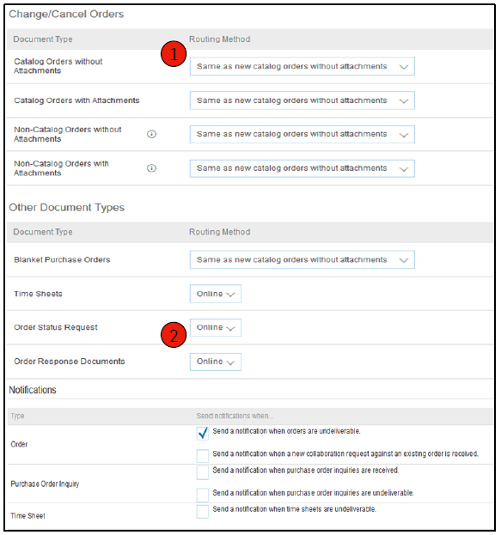
Selecting Your Electronic Order-Forwarding Method
Notifications
Select "As for new catalog orders without attachments" for order changes and other document types to copy the settings automatically. However, you can also choose the settings according to your preferences.
Specify a method and user for sending order response documents (confirmations and shipping notifications).

Slide 23
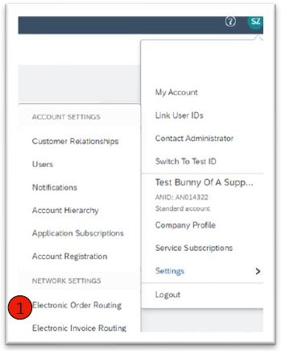
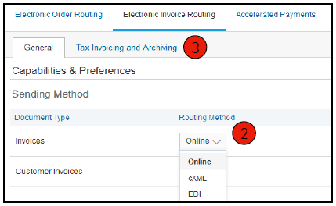
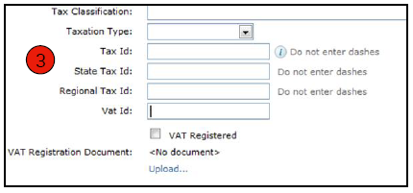
Selecting Your Electronic Order-Forwarding Method
Methods and Control Information
Select "Electronic invoice forwarding".
Select one of the following methods for electronic invoice routing: Online, cXML, EDI. It is recommended to configure notifications for forwarding via email (just like for purchase order forwarding).
On the Tax Invoices tab, click the Tax Information and Filing sub-tab to enter the tax number, sales tax number, and other relevant data.

Slide 24
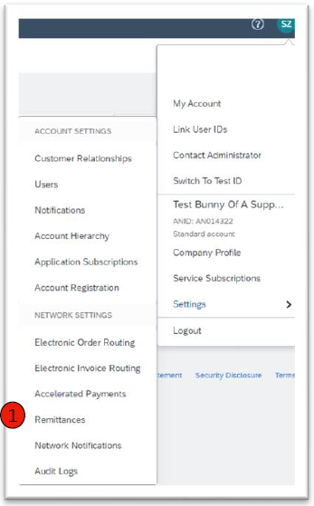
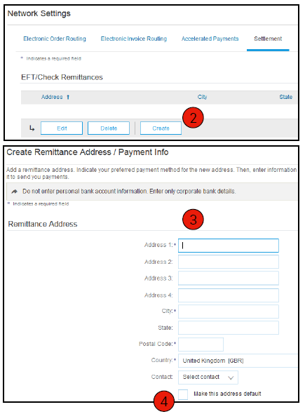
Configuring Transfer Information
From the Company Settings drop-down menu, click the Transfers option.
Click "Create" to create new remittance data for your company or "Edit" to modify existing data.
In the section "Transfers by ELV/Cheque", fill in all mandatory fields marked with an asterisk (*).
Set one of your remittance addresses as the default address if you have more than one. Assign each customer a remittance ID for that address if needed. Customers may ask you to assign IDs to their addresses so they can uniquely refer to those addresses. Each customer can assign different IDs.

Slide 25
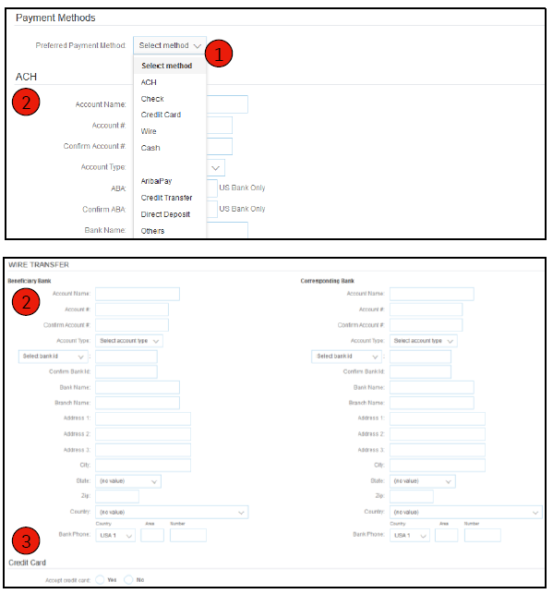
Configure Transfer Information
Payment Methods
Select the preferred payment method from a drop-down list: "Check", "Credit Card" or "Electronic Transfer".
Enter the details for "Automated Clearing House" or "Electronic funds transfer".
Indicate whether you accept credit cards, and then click OK.
Note: Unless specified, this does not change your customer's payment method.

Slide 26
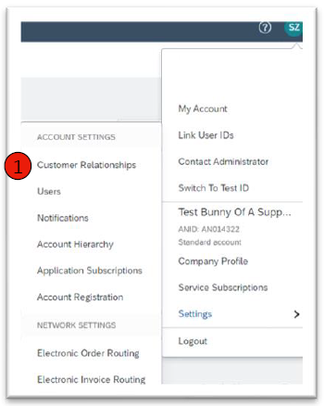
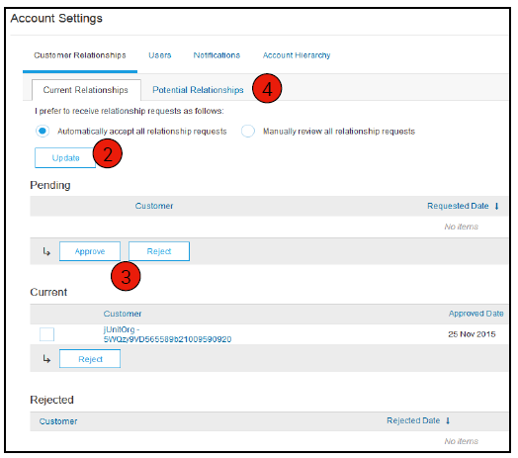
Reviewing Your Business Relationships
Current and potential customers.
In the Company Settings menu, click the "Customer Relations" link.
Choose whether you want to accept customer relationships either automatically or manually.
In the "Pending" section, you can approve or reject pending requests to establish a business relationship. In the "Current" section, you can review the profiles and information portals of your current customers. In the "Rejected" section, you can also review rejected customers.
Search for potential customers on the "Potential Business Relationships" tab.

Slide 27
Set up User Accounts
Roles and Permission Details
Administrator:
Only one administrator per ANID.
Automatically linked to the username and login provided during registration.
Responsible for account setup/configuration and management.
First point of contact for users with questions or problems.
Creates users and assigns roles/permissions to users of the account.
User:
Up to 250 user accounts per ANID.
May have different roles/permissions that correspond to the user's actual responsibilities within their job function.
Can access all clients or only specific clients assigned by the administrator.

Slide 28
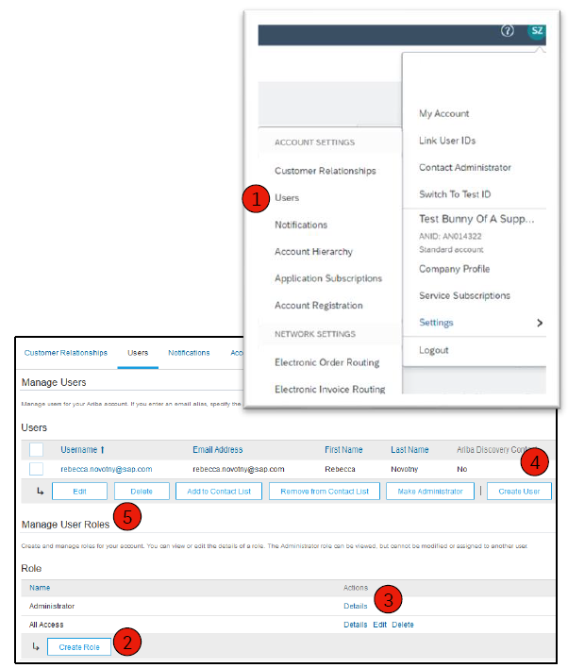
Set up User Accounts
Create roles and users (administrator only)
On the Users tab, open the Company Settings menu. The "Users" page is displayed.
In the Manage Roles section, click the Create Role button and enter a name and description for the role.
Add permissions to the role that correspond to the user's actual job responsibilities by selecting the appropriate check boxes and clicking Save to create the role.
To create a user, click the "Create User" button and add all the relevant data for the user, such as name and contact information.
In the Role Assignment section, select a role and click Done. You can add up to 250 users to your Ariba Network account.

Slide 29
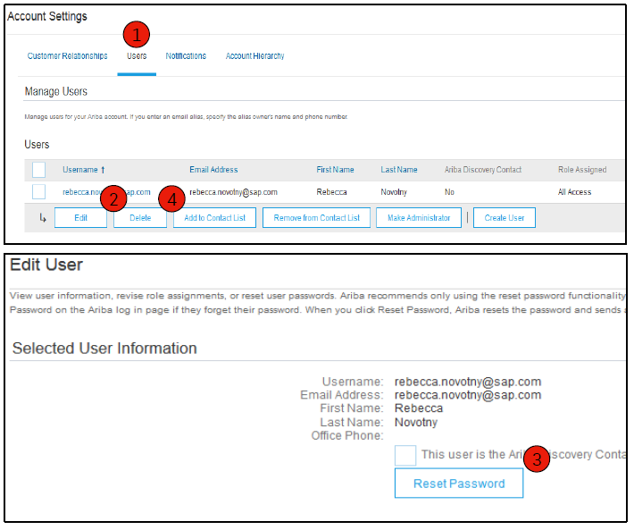
Set up User Accounts
Change user accounts (administrator only)
Click the Users tab.
Click Edit for the selected user.
Click the "Reset Password" button to reset the password for the user.
Other options:
    Delete user.
    Include in list of contacts.
    Remove from contact list.
    Make it an administrator.

Slide 30
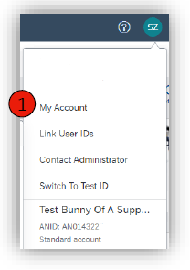
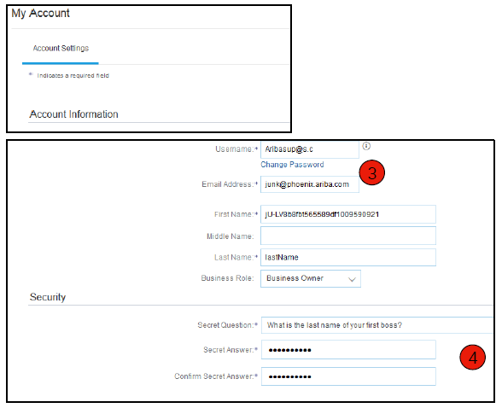
Advanced user account features.
Click on your name in the top right corner to access the user account navigator. Here you have the following options:
    Quickly access your personal user account information and settings.
    Link multiple user accounts.
    Switch to your test account.
    Note: After you link multiple user accounts, the User Account Navigator displays multiple accounts.
Click on "My account" to view your user settings.
Click "Complete" or update all mandatory fields marked with an asterisk (*). Note: If you change your username or password, remember to use them the next time you log in.
If necessary, hide your personal information by selecting the appropriate check box in the "Contact Information Preferences" section.

Slide 31
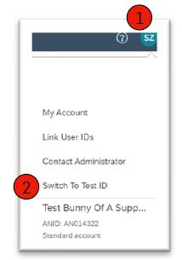
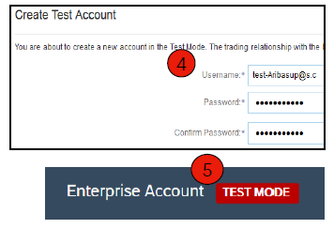
Set up a test account.
To set up your test account, you must be in the table view of your active Ariba Network account.
Click your name in the top right corner, then select "Switch to Test ID". The Switch to Test Account button is only available to the account administrator. The administrator can create test account usernames for any other users who need access to the test account.
Click OK when Ariba Network displays the following warning: "You are about to enter test mode."
Create a username and password for your trial account and click "OK". You will be redirected to your test account.
Your test account should already be configured in the same way as your active account. This ensures that the test results match the results in production. After you have set up your test account, you are ready to receive a test order.
Note: Test account transactions are free of charge.
The Network always indicates which mode you are logged in to (active account or trial account). For your test account ID, the suffix "T" has been appended to your Ariba Network ID (ANID).

Slide 32
Agenda
Ariba Network – an Overview
Account Setup
Purchase Orders
Other Documents
Invoice Types

Slide 33
Purchase Orders Management
Display purchase orders
Order details
Create PDF of the purchase order

Slide 34
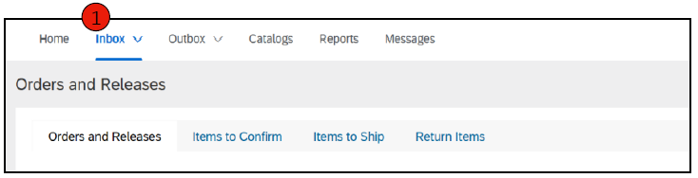
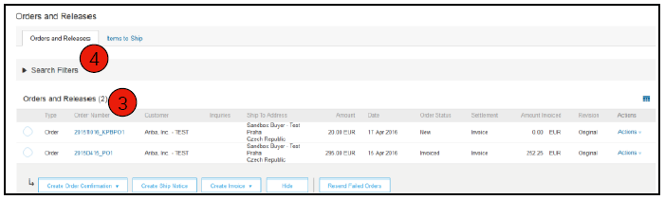
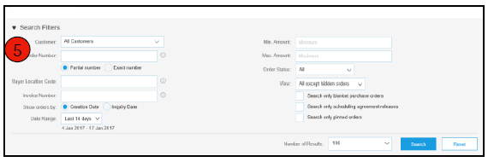
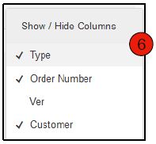
Purchase Orders Management
Display purchase orders.
Click the Inbox tab to manage your purchase orders.
The inbox is displayed in the form of a list of orders received from TÜV Rheinland.
Click on the link in the "Purchase Order Number" column to view the purchase order details.
The search filters allow you to search using multiple criteria.
Click the arrow next to "Search filter" to display the query fields. Enter your criteria and click "Search".
Toggle the table options menu to see ways to organize your inbox.
For standard account suppliers:
Use the order notification email sent to you to access the order on your AN account, and continue processing the order.
Puchase order not found?

Slide 35
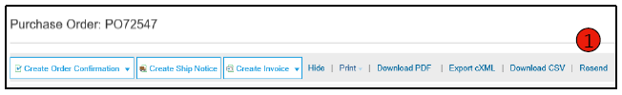
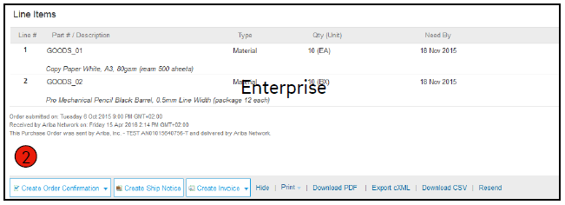
Purchase Orders Management
Purchase Order Details
View the details of your purchase order. The order header contains the order date and information about the buying company and the supplier.
Note: You can resend a purchase order that was not correctly delivered to your email address, as cXML or via EDI (for Enterprise Account) at any time by clicking the Resend button.
Other options: cXML export to save a copy of the cXML source data; order history to diagnose problems and audit the total value.
The items ordered are described in the "Items" section. Each position describes an item quantity that TÜV Rheinland would like to purchase. Set the status of the individual items by sending order confirmations. To do this, click on "Create order confirmation". You will find the subtotal at the bottom of the purchase order.

Slide 36
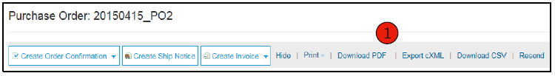
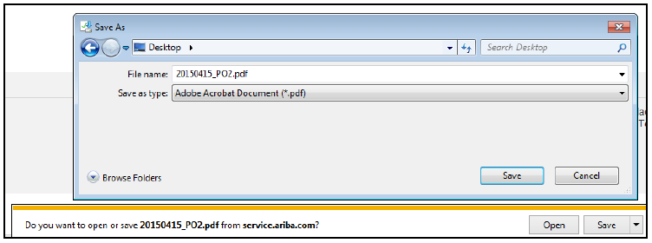
Purchase Orders Management
Create PDF of the purchase order.
Select "Download PDF" as shown.
Note: If the document is more than 1000 lines or larger than 1 MB, no details are displayed in the user interface. Therefore, no details are included in the generated PDF.

Slide 37
Agenda
Ariba Network – an Overview
Account Setup
Purchase Orders
Other Documents
Invoice Types

Slide 38
Other Documents
Order Confirmations (OC).
Advance Shipping Notices (ASN).
Confirm entire order
Reject entire order
Update positions
Shipping notification
Delivery conditions and Transportation Information
Details
Shipping notification and status

Slide 39
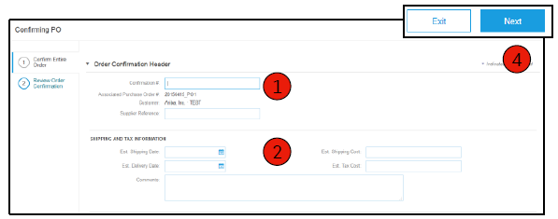
Creating Order Confirmation: Confirm Entire Order
This slide explains how to confirm the entire order.
Enter the confirmation number. This is any number you assign to identify the order confirmation.
If you specify an estimated shipping date or an estimated delivery date, this applies to all items.
You can group related items or combine goods so that they can be processed as a unit.
Click "Next" when you are finished.
Check the order confirmation and click on "Submit".
Your order confirmation will be sent to TÜV Rheinland.
Note: If your customer allows collaboration with suppliers on the Ariba Network (SNC), your order confirmation must be initiated in Ariba.
After the order confirmation is submitted, the order status changes to "Confirmed". When you view documents online, links to all related documents are displayed. Click "Done" to return to the inbox.
For standard account suppliers:
Use the order notification email sent to you to access the order on your AN account and continue processing the order.
Problems with your order confirmation?

Slide 40
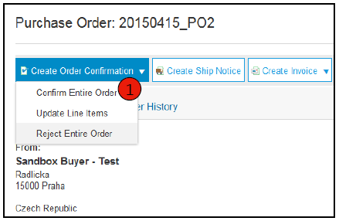
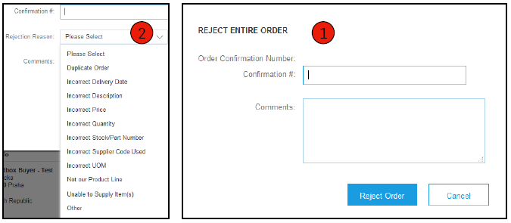
Creating Order Confirmation: Reject Entire Order
Click on the "Create Order Confirmation" button in the order view and select "Confirm entire order", "Update items" for individual items or "Reject entire order".
Enter a reason for rejecting the order if your buyer asks for a reason.
This example shows the "Reject entire order" option. (An update with a different status is explained later in this presentation).
Please check your customer's transaction rules to see if you are authorized to reject orders. You can view the transaction rules directly in your supplier account: Initials Settings Customer Relationship
Click directly on the customer name and the transaction rules assigned to you will be displayed.

Slide 41
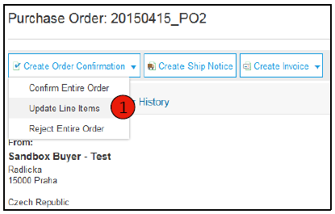
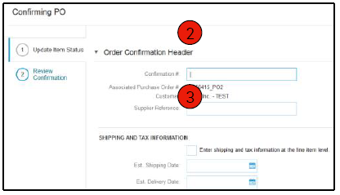
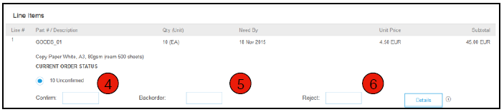
Creating Order Confirmation: Update Line Items
Select the "Update items" option to set the status of each item individually.
Enter all the required information (as for the "Confirm all" option).
Scroll down to display the items and select from the possible values:
Confirm: You have received the order and will ship the ordered items.
Reorder: The items are reordered. After they are back in stock, generate another order confirmation to set it to "Confirmed".
Reject: Enter a reason for rejecting these items in the "Notes" field by clicking the "Details" button.
Note: If your customer allows collaboration with suppliers on the Ariba Network (SNC), your order confirmation must be initiated in Ariba.

Slide 42
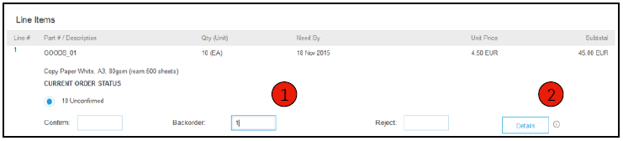
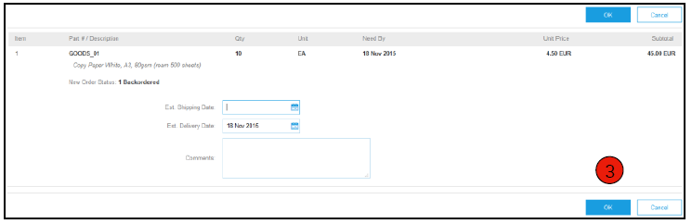
Creating Order Confirmation: Line Items Updates, Re-Orders
Update positions - reorder
Enter the reordered quantity in the data entry field "Reorder".
Click Details to enter comments and estimated shipping and delivery dates for the reordered items on the Status Details page.
Click "OK" when you are finished.
Note: If you use multiple statuses for an item, the sum of the quantities of the individual statuses must equal the item quantity.
Click on "Next".

Slide 43
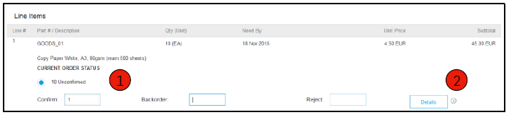
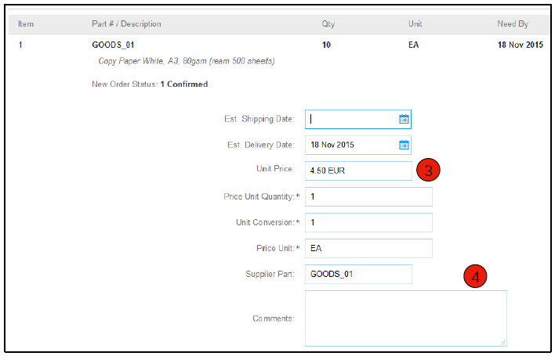
Creating Order Confirmation: Line Item Updates, Price Changes
Enter the quantity in the data entry field "Confirm".
Click on "Details" to enter the details of the price change.
Record the new price in the Price per ME field on the Status Details page for the line item. Enter a note about the price change if required. Substitute items can also be named for the requested item using the "Vendor Item" field.
Update the description if necessary and click "OK" when you are done.

Slide 44
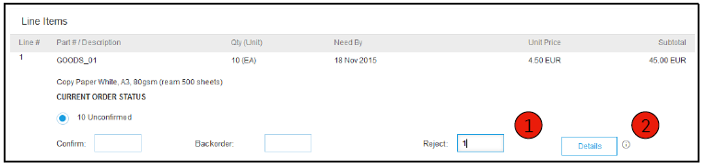
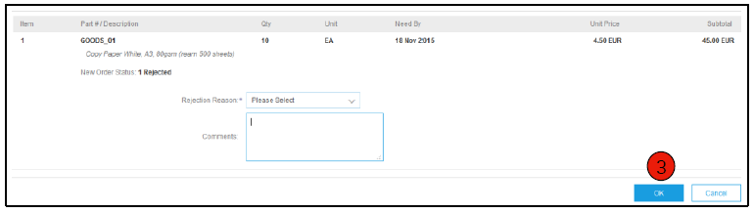
Creating Order Confirmation: Line Item Updates, Rejecting
In the Reject data entry field, enter the quantity to be rejected.
Click the Details button to enter a reason for the rejection in the Notes field on the Status Details page.
Click "OK" when you are finished.

Slide 45
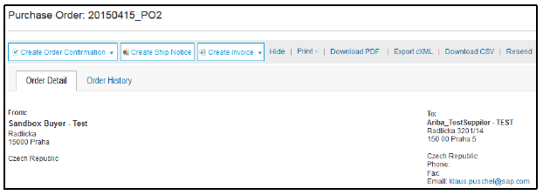
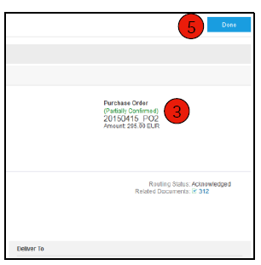
Creating Order Confirmation: Line Item updates
Continue updating the status for each line item in the order. When you are finished, click "Next" to jump to the review page.
Check the order confirmation and click on "Submit". Your order confirmation will be sent to TÜV Rheinland.
Partially confirmed" is displayed as the order status if items have been reordered or not fully confirmed.
Generate another order confirmation to set you to "Confirmed" if needed.
Click Done to return to the Inbox.

Slide 46
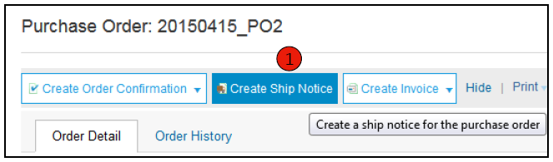
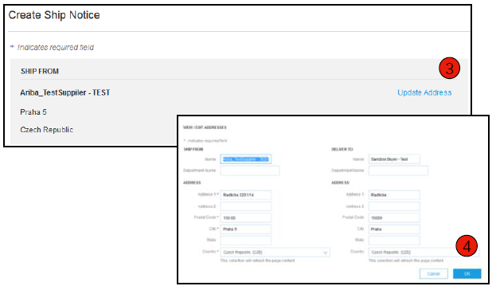
Creating Shipping Notifications
Create a shipping notification from your Ariba account after you ship the items. Multiple shipping notifications can be sent per order. Click the Create Shipping Notification button.
Enter all required data on the shipping notification form. The packing slip ID is any number you assign to identify the shipping notification. Select the name of the carrier. The "Tracking No." and "Shipping Method" fields will then appear. "Gross Volume and Gross Weight are optional fields that appear when Collaborative Supply Chain (CSC) is enabled.
Enter the sender data under "Sent by" by clicking on "Update address". All fields marked with an asterisk (*) are mandatory fields.
Also check the recipient data for correctness. Click on "OK".
For standard account suppliers:
Use the order notification email sent to you to access the order on your AN account and continue processing the order.

Slide 47
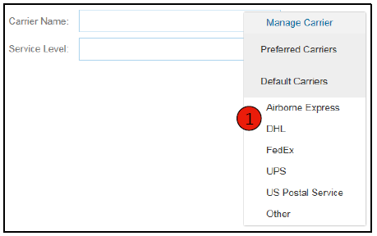
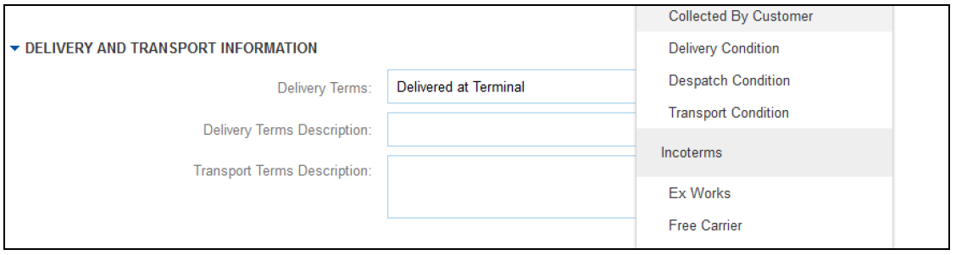
Creating Shipping Notifications: Delivery Conditions, Transport Information
Delivery terms and other shipping data can be included in all pre-shipment notifications (shipping notifications) to provide more shipping information for better collaboration.

Slide 48


Creating Shipping Notifications: Detail Information
Scroll down to view item information and update the quantity shipped for each item.
Part No. of the customer is displayed if the collaborative supply chain (CSC) has been implemented.
Click "Next" to continue reviewing your shipping notification.

Slide 49

Submit Shipping Notifications
After reviewing your shipping notification, click "Submit" to send the shipping notification to TÜV Rheinland. Shipping notifications improve communication to avoid unnecessary calls to the order processing/purchasing department.
After you submit your shipping notification, the order status changes to "Shipped". Submitted shipping notifications can be viewed in the Outbox (Enterprise Account) or by clicking the link under "Related Documents" in the Order View. For Standard Account, the shipping notifications are listed under the corresponding tile on the home dashboard.
Click "Done" to return to the home page.

Slide 50
Service Entry Sheets

Slide 51
Agenda
Ariba Network – an Overview
Account Setup
Purchase Orders
Other Documents
Invoice Types

Slide 52
Invoice Types
Invoice
information.
Invoice types.
Billing management.
Billing Rules.
Purchase Order Conversion (PO Flip).
Invoices for blanket purchase orders.
Contract Invoices.
Billing Corrections.
Copy invoices.
Search by bill.
Check invoice status.
Invoice History.
Change bills.
Accounting Reports.
Invoice archiving.

Slide 53
Invoicing Requirements
Please submit invoices via Ariba Portal (preferred format). If you are unable to submit the invoice via Ariba Portal, please refer to the instructions on our purchase orders under Invoicing-related terms and Conditions of Purchase.
In order to facilitate a speedy processing and reduce queries, we urge you to note the following points:
For delivery (on the outside of the packaging), invoice and correspondence, our order number must be clearly legible, otherwise the acceptance, payment or processing can not take place.
Please refer to one order only for invoices (partial delivery / partial billing possible).
Please list items on your documents analogous to the order items (e.g. item number, article description, quantity and price units).
Please only invoice order items. Other costs, e.g. freight, packaging and travel costs may only be invoiced as agreed in the purchase order.

Slide 54

TÜV Rheinland's Invoicing Rules
These rules determine which data you can enter when creating invoices.
Log in to your Ariba Network account at supplier.ariba.com
Select the Company Settings drop-down menu and click Customer Relationships under Account Settings.
A list of your customers is displayed. Click on the name of your customer (TÜV Rheinland).
Scroll down to the Billing Setup section and learn about the general billing rules.
If TÜV Rheinland has activated country-dependent invoice rules, you can select your country from the "Country in which the invoice was created" drop-down list.
When you are finished, click Done.

Slide 55



Invoicing from a Converted Purchase Order
To create an invoice from a converted purchase order (an invoice derived from a purchase order received through Ariba Network):
On the home screen of your Ariba Network account, select the Create drop-down menu and select Invoice for Purchase Order.
Select a purchase order number for "Invoice for purchase order".
Click the Create Invoice button and then select the Standard Invoice option.
The invoice is automatically pre-populated with the data from the purchase order. Enter data in all fields marked with an asterisk and add taxes as needed. Review your invoice for accuracy on the Review page. If no changes are required, click Submit to send the invoice to TÜV Rheinland.
For standard account suppliers:
Use the order notification email sent to you to access the order on your AN account and create an invoice.

Slide 56




Invoicing from a Converted Purchase Order
Invoice Header
Select customer must be completed
The invoice is automatically pre-populated with the data from the purchase order. Enter the data in all fields marked with an asterisk and add taxes as required.
Enter an invoice number. This is your unique number to identify the invoice. The invoice date is entered automatically.
Select the desired payee from the drop-down list if you have stored several billing addresses.
Shipping and tax data can be entered at either header or item level by selecting the appropriate radio button.
You can add more data to the invoice header such as: Processing costs, payment terms, notes, attachments, shipping documents.
Scroll down to the Line Items section to select the line items to be invoiced.
Note: Additional reference documents and data are only supported for Collaborative Supply Chain (CSC) customers. Files added as attachments must not exceed 40MB in size.

Slide 57





Invoicing from a Converted Purchase Order
Invoice Line Items
The "Items" section contains the items from the purchase order.
Check or update the quantity for each item you want to invoice.
Click on the green oval of an item if you do not want it to be invoiced to exclude it from the invoice, OR click on the checkbox to the left of the item and then click "Delete" to remove the item from the invoice. You can generate another invoice later to bill this item.
Select the line items that are tax relevant by using the checkbox of the line item numbers. To apply the same tax rate to multiple line items, select the line items to which you want the same tax rate to apply.
To configure additional control options in the Control Category Functions, use the Configure Control Menu option.
Select the checkbox next to "Tax category" and select one of the options displayed in the drop-down list. Click "Include in included items".

Slide 58




Invoicing from a Converted Purchase Order
Additional tax options and Item Shipping
To configure additional tax options, click Configure Tax Menu in the Tax Category drop-down list. Create new tax categories as required.
Select the item to specify different tax rates for each item.
Click on "Position Actions" > "Add" > "Tax". After the update, the tax fields are displayed for each selected position.
To remove a control item, click Delete if it is not needed.
For each line item, select the category, enter either the tax rate (%) or the tax amount, and click Update.
Enter the shipping costs for the relevant items if "Shipping at item level" has been selected.

Slide 59


Checking for Allowances and Fees in Invoices
If allowances and charges are included in the purchase order, they are also converted and included in the invoice at the header or item level, depending on where this information is included in the purchase order:
Allowances and fees in the document header.
Allowances and charges at item level.

Slide 60

Invoicing from a Converted Purchase Order
Invoice Line Items
Further information at item level can be displayed by editing an item.

Slide 61

Invoicing from a Converted Purchase Order
Notes on a Line Item
To add annotations to items, select items and then click Item Actions > Add > Annotations.
After updating, the "Annotations" field is displayed. Enter the desired annotations in this field.
Click on "Next".

Slide 62
Invoicing from a Converted Purchase Order
Compare invoice with the goods receipt document.
Only quantities received may be included in invoices.
Click the Inbox tab.
Select the purchase order for which an invoice is to be issued.
In the receipt document list, select the items for the invoice.
The invoice is now pre-populated with the items from the goods receipt document. You can now select the items to be included in the invoice and/or change the quantities in the invoice.

Slide 63
Invoicing from a Converted Purchase Order
Match invoice with the shipping notification.
Only dispatched (delivered) quantities may be included in invoices.
Click the Inbox tab.
Select the shipping notification for which an invoice is to be issued.
The invoice will now be pre-populated with the items from the shipping notification. You can now select the items to include in the invoice and/or change the quantities in the invoice.

Slide 64


Invoices with Service Items
Adding Service Line Items in Invoices
From the Add drop-down menu, select Add General Service OR Add Service.
Enter the details for the added general service or for the added service. For a general service, only certain information such as start and end date of the service needs to be entered. The details for the service include additional fields such as rate, terms, and information about external collaborators.

Slide 65

Invoicing based on Blanket Purchase Order
A. Find blanket purchase order.
To create an invoice from a blanket purchase order:
Look for the blanket purchase order in the inbox.
Click on "Create invoice" and select "Standard invoice".
For standard account suppliers:
Use the order notification email sent to you to access the order on your AN account, and continue processing the order.
Blanket purchase order requires release?

Slide 66


Invoicing based on Blanket Purchase Order
B. Header Information
Enter information in all fields marked with an asterisk (*) as mandatory and, if applicable, in the header.
Check the box of the item for which you want to create an invoice.
Click Create at the bottom and select "Goods" or "Services".

Slide 67

Invoicing based on Blanket Purchase Order
C. Create a line item.
Update mandatory fields such as "Quantity" and/or "Price" to create the invoice line item. Click "Create" when you are finished.

Slide 68

Invoicing based on Blanket Purchase Order
D. Review of Information.
After completion, the invoice item is displayed as a sub-item (i.e. 1.1) indicating the quantity invoiced.
Repeat the process for each position if necessary.
Click Next to continue.
Review or save the invoice or submit it as a standard invoice.
Remaining amount?

Slide 69



Invoicing based on a Contract
How to create a contract invoice:
On the home screen of your Ariba Network account, select the Create drop-down menu and choose Contract Invoice.
Select the entry for TÜV Rheinland from the "Customer" drop-down list.
Complete the invoice entry by filling in all fields marked with an asterisk (*).

Slide 70




Invoicing based on a Contract
Options at header and item level.
There is an option to add taxes, shipping dates, handling charges, cash discounts, notes and attachments to contract invoices.
To add items to the invoice:
Select catalog and non-catalog options.
Fill in the mandatory fields marked with an asterisk (*).
Update the total amount.
Click the "Submit" button to submit the invoice.
Are no articles displayed?

Slide 71

Creating a Credit Memo
A. Head level.
To create an invoice correction for an entire invoice:
Select the Inbox tab.
Select the purchase order to be corrected by activating the radio button on the purchase order.
Click Create Invoice and select Invoice Correction or select Invoice Correction from the Actions drop-down menu.
Enter the required data in the invoice correction form (invoice amount and tax amounts are automatically displayed as negative). Fill in all mandatory fields marked with an asterisk (*).
Click on "Next".
Check the invoice correction.
Click on "Submit".
For standard account suppliers:
Use the order notification email sent to you to access the order on your AN account, and continue processing the order.

Slide 72



Creating a Credit Memo
B. Item Level Details.
To create an item-level invoice correction for an invoice:
Select the Outbox tab.
Select the previously created invoice.
In the Invoice view, click the Create Invoice Correction at Line Item Level button.
Enter the required data in the invoice correction form (invoice amount and tax amounts are automatically displayed as negative). Fill in all mandatory fields marked with an asterisk (*).
Click on "Next".
Check the invoice correction.
Click on "Submit".

Slide 73



Review, Save or Submit an Invoice
Invoice from converted purchase order
Review your invoice for accuracy on the Review page. Scroll down the page to view all line item details and invoice totals.
If no changes are required, click Submit to send the invoice to TÜV Rheinland.
If changes are required, click Back to return to the previous screen and make corrections before submitting the invoice.
You can also save your invoice at any time during creation to continue editing later.
You can continue editing the invoice by selecting it in Outbox > Drafts on the Home screen.
You can keep draft invoices for up to 7 days.
Note: In the event of incorrect entries, you will receive a note in red text where data must be corrected.
For standard account suppliers:
Use the order notification email sent to you to access the order on your AN account, and continue processing the order.

Slide 74


Copying an Existing Invoice
To copy an existing invoice to create a new invoice:
Select the Outbox tab.
Select the radio button for the invoice you want to copy and click Copy. Or, open the invoice you want to copy.
On the Details tab, click Copy This Invoice.
Enter a new invoice number.
For sales tax items, ensure that the delivery date is correct at the item level.
Edit the other fields as required.
Click "Continue", review the invoice and save or submit it.
For standard account suppliers:
Use the order notification email sent to you to access the order on your AN account, and continue processing the order.

Slide 75



Searching by Invoice
Quick search and differentiated search
Quick search:
On the home page, select "Invoices" as the document type to search for.
Select TÜV Rheinland from the "Customer" drop-down menu.
Enter the invoice number, if known. Select a date range (for invoices up to 90 days) and click "Search".
Differentiated search: Allows a differentiated search for invoices from the last 90 days.
Click on the arrow next to "Search filter" in the outbox (invoices).
Enter the criteria to create the desired search filter.
Click on "Search".

Slide 76
Checking Invoice Status
Status of Invoice Submission
Check Status:
If you have configured your invoice notifications as outlined earlier in this presentation, you will receive invoice status emails.
You can also check the invoice submission status in the outbox by clicking on the invoice link.
Forwarding/Submission Status:
Indicates the status of the transfer of the invoice via Ariba Network to TÜV Rheinland.
Expired: You have cancelled the invoice.
Failed: The invoice does not meet TÜV Rheinland's invoicing rules. TÜV Rheinland will not receive this invoice.
Wait: The invoice was received on Ariba Network, but not processed.
Sent: Ariba Network has sent the invoice to a queue. The invoice is there for the customer to pick up.
Confirmed: TÜV Rheinland's invoicing application has confirmed receipt of the invoice.
For standard account suppliers:
Check the invoice status using the corresponding document tile on the home dashboard in your account.

Slide 77
Checking Invoice Status
Check invoice status as actions taken by customer.
Invoice status
Indicates the status of the action performed by TÜV Rheinland in relation to the invoice.
Sent: The invoice has been sent to TÜV Rheinland, but has not yet been reconciled there with purchase orders and receipts.
Cancelled: TÜV Rheinland has approved the invoice cancellation.
Paid: TÜV Rheinland has paid the invoice or is in the process of issuing the payment order. Only if TÜV Rheinland triggers the payment process via invoices.
Approved TÜV Rheinland has checked the invoice against the purchase orders or contracts and receipts and approved payment of the invoice.
Rejected: TÜV Rheinland has rejected the invoice or the invoice has not passed Ariba Network's review. If TÜV Rheinland accepts the invoice or approves the payment, the invoice status changes to Sent (invoice accepted) or Approved (invoice payment approved).
Failed: A problem occurred on Ariba Network while forwarding the invoice.

Slide 78


Invoice History
Check status notes.
Open any invoice:
Click the History tab to view status details and invoice history.
History and status notes are displayed for the invoice.
Transaction history can be used to troubleshoot failed or rejected transactions.
When you have finished checking the history, click Done.
For standard account suppliers:
Use the order notification email sent to you to access the order on your AN account.

Slide 79


Change Existing Invoices
Cancel, edit and resubmit.
Click the Outbox tab.
Click a link in the Invoice Number column to view the invoice details.
Click on "Cancel". The status of the invoice changes to Canceled.
Click the invoice number of the failed, canceled, or rejected invoice you want to resubmit and click Edit.
On the Review page, click Submit to send the invoice.
For standard account suppliers:
Use the order notification email sent to you to access the order on your AN account, and continue processing the order.

Slide 80

Download Invoicing Reports
Transaction Information
Reports provide additional information and details about transactions on the network in an easy-to-read format.
Click the Reports tab in the menu at the top of the page.
Click Create.
Invoice reports contain information about invoices you have sent to customers. You can track invoices over a period of time or the total volume of invoices within a period of time.
Failed Invoice Reports provide details of failed or rejected invoices. These reports can help troubleshoot invoices that are not routed properly.
Reports can be created by the administrator or by users with the appropriate permissions.
Bronze members (and higher level members) can choose between manual and scheduled reports. Enter schedule data when a scheduled report is selected.
For standard account suppliers: Not available

Slide 81


Accounting Reports
Enter the necessary information. Select an invoice report type: Failed Invoice or Invoice.
Click on "Next".
Enter the customer and the creation date under "Criteria".
Click on "Submit".
You can view and download the report in CSV format if its status has changed to Processed.
For more detailed instructions on generating reports, see the Ariba Network Transaction Guide on the Help page of your account.
For standard account suppliers: Not available

Slide 82



Invoice Archive
By configuring invoice archiving, you can specify the frequency, immediacy, and deployment of compressed invoice archives. To use this feature, complete the following steps:
From the Company Settings drop-down menu, select Electronic Invoice Forwarding.
Choose the Tax Invoices and Archiving tab.
Scroll to Invoice Archiving and click the Configure for Invoice Archiving link.
Specify the frequency ("Twice a day", "Daily", "Weekly", "Every two weeks", or "Monthly"), check the "Archive immediately" box to begin archiving without a 30-day waiting period, and click Start.
If you want Ariba Network to automatically deliver archived zip files to you, also specify an archive delivery URL (otherwise, you can download invoices from the Archived Invoices section of the Outbox page).
Note: Once Archive Immediately has been started, you can either stop the process or update the frequency at any time.
You can navigate back to the Tax Billing and Archiving screen to subscribe to Long-Term Document Archiving for an integrated archiving solution. (See the Terms of Use and Policies link for more details).
For standard account suppliers: Not available

Slide 83
Ariba Network Help Resources
Customer Support
Supplier Information Portal
Additional
Resources
Ariba.com Links
Troubleshooting problems with invoices

Slide 84
Customer Support
Support of suppliers during implementation
  Support for registering or configuring Ariba Network
  Registration, supplier fees, account configuration
  Via SAP Ariba Help Center
  Support for the business process of activating TÜV Rheinland
  Business-related questions for your TÜV Rheinland purchaser or
  Email to Global-Office-Procurement@de.tuv.com
  TÜV Rheinland supplier information portal
  TÜV Rheinland website (external)
  Supplier information portal (via AN supplier account)
Support for suppliers after the launch
Global customer support
Use Help Center directly from your Ariba Network account.

Slide 85

Training and Resources
TÜV Rheinland supplier information portal on Ariba Network.
Select the "Company settings" menu at the top right and then click on the "Customer relationships" link.
Select the buyer name to view transaction rules. The customer invoice rules determine what you can enter when creating invoices.
Select Supplier Information Portal to view documents provided by the buyer.

Slide 86
Useful Links
Ariba supplier pricing page - http://www.ariba.com/suppliers/ariba-network-fulfillment/pricing
Ariba Network: Current Issues and Frequently Asked Questions (FAQ) - https://connect.ariba.com/anfaq.htm
Ariba Cloud Statistics - http://trust.ariba.com
Detailed information and recent announcements about product issues and planned downtime (if any) for a particular day
Ariba Discovery - http://www.ariba.com/solutions/discovery-for-suppliers.cfm
Ariba Network Cloud Status - https://www.sap.com/about/trust-center/cloud-service-status.html#sap-ariba
(Information about downtimes)

Slide 87
Troubleshooting problems with invoices.
How do I know what type of invoice to create?
What does this
Error message?
How do I cancel an invoice that I have sent?
Can I have a
failed/
rejected
Invoice with
of the same
Invoice
number again
send?
How do I edit
a bill which
I sent,
and hand them
again?
How do I proceed,
when my
Invoice
Rejected
was?
How do I know
when my
bill paid
will?

